Slide 1
CS-200-1: Programming I
If you are on the wait-list, please do not sit down yet. I will add wait-listed students to the course based on their wait-list position and the number of available seats.

Slide 2
Lecture 1: Welcome to Programming I!
Reading: Chapter 1, Sections 1.1 - 1.6
Introduction to Computers, Programs and Java

Slide 3
Things to know about this course
The course website is located at: www.homepages.neiu.edu/~retrana/CS200.html
Updates for the course can be found under “News Items” on the course website.
Lectures and study guides will be posted on the course website. You should bring the study guides to class and use them for taking notes.
You will be using D2L for turning in homework.
Grades will be available on D2L.
Attendance is mandatory - it accounts for 5% of your grade!
There will be several programming labs/projects assigned throughout the semester. These projects MUST be done in pairs.
Notes:
Re: Assignments. You may work together on homework.
Start early!! You can print out the questions to work on them and ask questions prior to submitting your homework. If you are unable to complete your assignment in one sitting, utilize the “Save & Exit” button to save your work and complete it at a later time. Assignments that are saved are not recorded as an attempt until you choose to hit the “Submit Assignment” button. As a reminder, there are no late homework submissions. The homework is automatically submitted for you at the specified due date and time, if you have not already submitted it. There are no extensions or re-takes.

Slide 4
Things to know about this course
All assignments must be submitted to D2L by the specified due date and time. Late assignments will automatically receive half-credit (no exceptions) prior to any grading schema that is applied. Assignments submitted later than a week past the assigned due date and time will not be accepted (no exceptions).
Start early on your assignments!!!
The solutions will be posted after the homework is due - which is why there are no extensions.
You can work together on the homework. The goal is to understand the homework so that you can excel on quizzes and exams.
You get credit just for attempting each problem on the homework - even if it’s wrong (you should try to get it right though...)!
Notes:
Re: Assignments. You may work together on homework.
Start early!! You can print out the questions to work on them and ask questions prior to submitting your homework. If you are unable to complete your assignment in one sitting, utilize the “Save & Exit” button to save your work and complete it at a later time. Assignments that are saved are not recorded as an attempt until you choose to hit the “Submit Assignment” button. As a reminder, there are no late homework submissions. The homework is automatically submitted for you at the specified due date and time, if you have not already submitted it. There are no extensions or re-takes.

Slide 5
Things to know about this course
Monday, October 20, 2014: Midterm
Friday, November 7, 2014: Last day to drop and receive a "W" grade.
There will be a common final exam for all sections of Programming I. The CS-200 common final is scheduled for Saturday, December 6th, from 8:30 a.m. - 10:30 a.m. in LWH 1001.
There are two portions to the common final - a tracing portion and a coding portion.
If you do not receive 60% or higher on each portion of the final exam, you will receive a 'D' or 'F' for the course, regardless of your performance during the semester.

Slide 6


Things to know about this course
I cannot stay after class on Mondays as I have a class immediately following this one. If you have questions on Mondays, please ask them at the beginning of class or come to office hours or send me an email.
On Mondays, after class,
my answer will be:

Slide 7
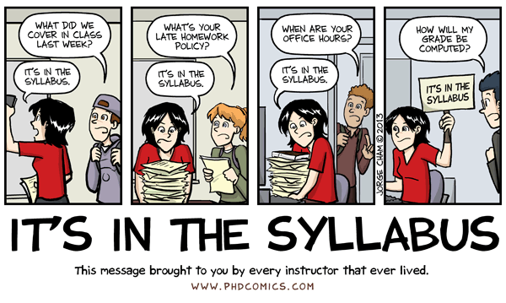
If you are wondering about grades, policies, etc.

Slide 8
Let’s Get started!

Slide 9
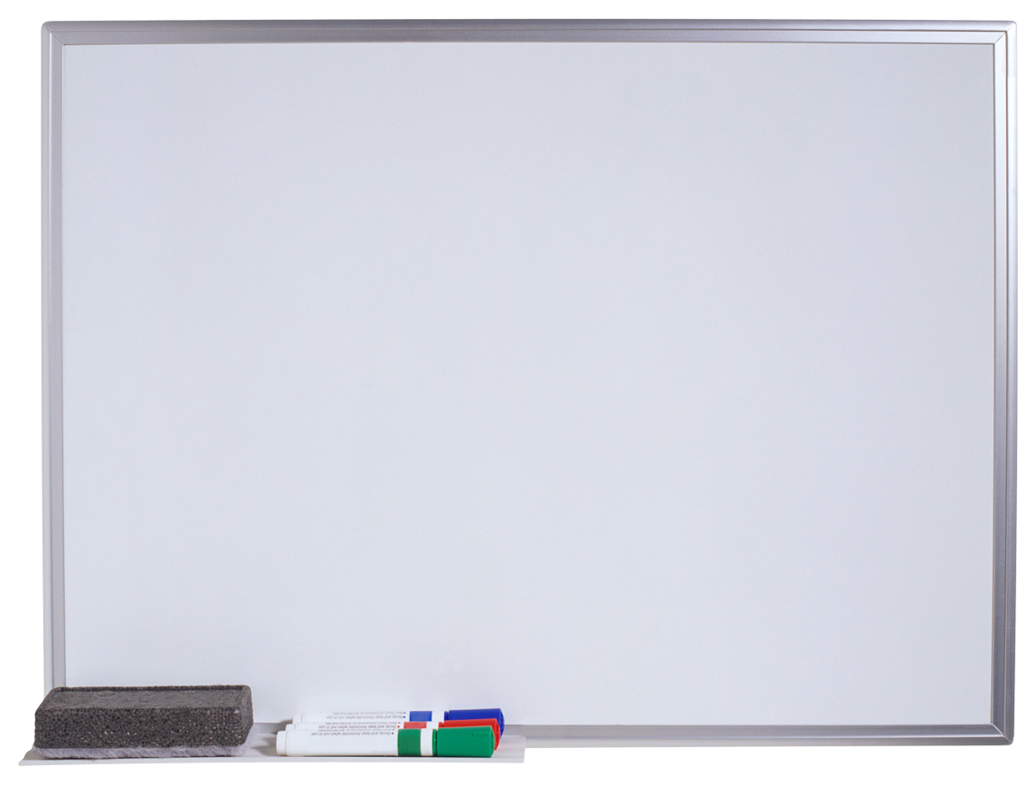
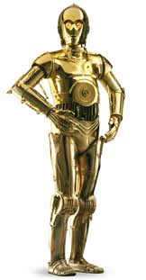
It’s an exciting time to be in computing!
Human Genome Project
GPS
Medical Imaging
Robots!
INTERNET
World Community Grid
Game Programming
AMBERTM Alert
Internet TV

Slide 10
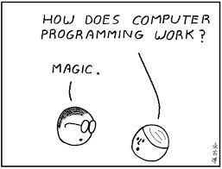
What is programming?
Programming is instructing a computer to do something for you with the help of a programming language.
The set of instructions that you provide to the computer is called a program.
The role of a programming language can be described in two ways: - Technical: It is a means for instructing a computer to perform tasks - Conceptual: It is a framework within which we organize our ideas about things and processes.

Slide 11
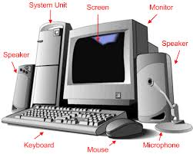
What is a computer?
An electronic device that stores and processes data. It includes both software and hardware.
A computer’s components are interconnected by a subsystem called a bus, which is built into a PC’s motherboard.

Slide 12
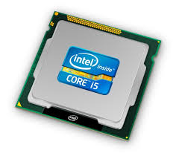
CPU
Central Processing Unit (CPU): The computer’s brain.
It receives instructions from memory and executes them.
Two components: A control unit and an arithmetic/logic unit.
Control unit: Controls and coordinates the actions of the other components.
Arithmetic/logic unit: Performs numeric operations (addition, subtraction, etc) and logical operations (comparisons).
CPUs are built on small silicon semiconductor chips that contain millions of transistors for processing information.

Slide 13
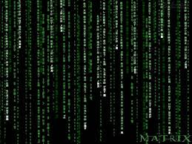
Bits and Bytes
Each switch in a computer is either on or off.
Switch is on: Value is 1
Switch is off: Value is 0
These 0’s and 1’s are interpreted as digits in binary and are called bits (binary digits).
Byte: Minimum storage unit in a computer. There are 8 bits in a byte.
Data (numbers, characters, etc) are encoded as a series of bytes.

Slide 14
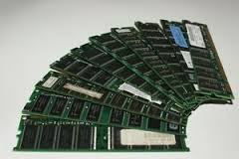
Memory
Computer memory: An ordered sequence of bytes for storing programs as well as data that the program is working with.
Every byte in the memory has a unique address, which is needed for locating the byte when storing and retrieving data.
Random-access memory (RAM): Bytes in memory can be accessed in any order.

Slide 15
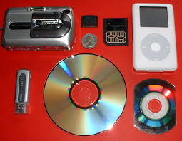
Storage Devices
Why not use just RAM? Volatile - any information that has been stored in memory is lost when the power is turned off.
Storage devices: Magnetic disk drives, CD/DVD, USB flash drives
Data is permanently stored on the drive and moved to memory when the computer uses them.

Slide 16
Input/Output Devices
Devices that let the user communicate with the computer.
Input: keyboards and mice
Output: monitors and printers
Communication devices: Allow computer networking. Exs: Dial-up modem, DSL lines, cable modem, network interface cards, wireless connections.

Slide 17
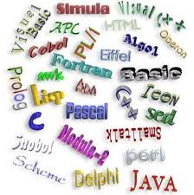
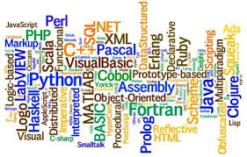
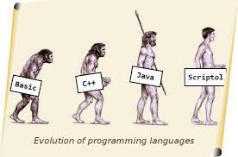
Programming Languages

Slide 18
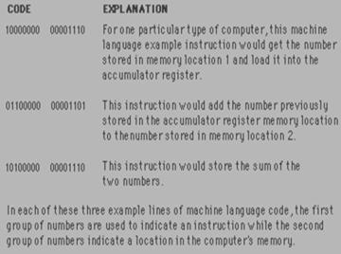
Machine Language
Long groups of 0’s and 1’s that instruct computers to perform their most elementary operations.
Machine dependent.
Slow and tedious
Programmers began using English-like abbreviations to represent elementary operations.

Slide 19
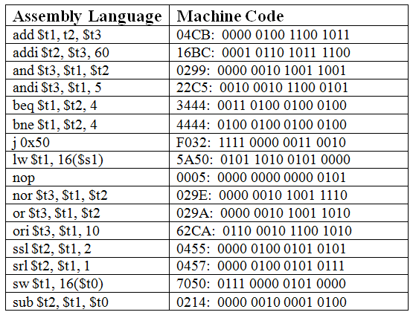
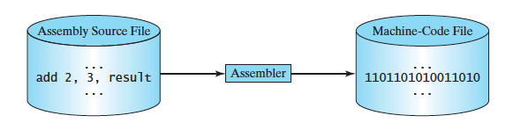
Assembly Language
Uses short descriptive words, known as a mnemonic, to represent each of the machine-language instructions.
Assemblers (translator programs) then converted to translate the assembly language into machine code.
Still many instructions to complete even a simple task.
Low-level language.

Slide 20
High-level Languages
A program written in a high-level language is called a source program or source code.
A computer cannot execute a source program.
Some high-level languages use compilers that translate the entire source code into a machine-code file and then the machine-code file is executed. These are called compiled languages.
Other high-level languages use interpreters that read one statement from the source code, translate that statement into machine code and then execute it right away, before moving on to the next statement. These are called interpreted languages.
A combination of both solutions has become very common (Python, Java, C#): a compiler can translate the source code into some intermediate form (often called bytecode), which is then passed to an interpreter which executes it.

Slide 21
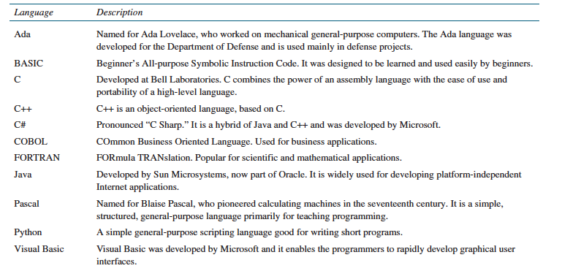

Slide 22
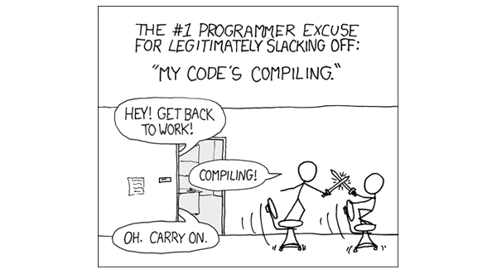

Slide 23
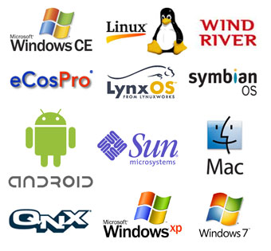
Operating Systems
Controls and monitors system activities
Allocating and assigning system resources.
Schedules operations: Multiprogramming, multithreading, multiprocessing (aka parallel processing)
Multiprogramming: Lets multiple programs run simultaneously. Multithreading: Allows a single program to execute multiple tasks simultaneously. Parallel processing: Uses two or more processors together to perform subtasks concurrently and then combine solutions of the subtask to obtain a solution for the entire task.

Slide 24
Let’s talk about...Java
1991: James Gosling at Sun Microsystems designed a language for programming home appliances (originally called Oak).
It was renamed Java in 1995 and redesigned for developing Web applications.
Java characteristics: simple, object oriented, distributed, interpreted, robust, secure, architecture neutral, portable, high performance, multi-threaded and dynamic.

Slide 25
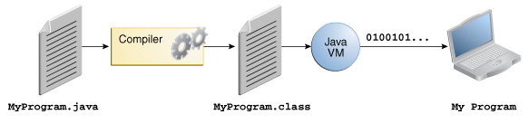
In the Java programming language, all source code is first written in plain text files ending with the .java extension.
Those source files are then compiled into .class files by the javac compiler.
A .class file does not contain code that is native to your processor; it instead contains bytecodes — the machine language of the Java Virtual Machine (Java VM).
The java launcher tool then runs your application with an instance of the JVM.

Slide 26
The Java Language Specification
Java syntax is defined in the Java language specification.
The Java library is defined in the Java Application Program Interface (API).
The Java language specification is a technical definition of the Java programming language’s syntax and semantics (http://docs.oracle.com/javase/specs/).
Java comes in three editions: - Java SE: To develop client-side applications (standalone applications, web applets). - Java EE: To develop server-side applications. - Java ME: To develop mobile applications.

Slide 27

That’s all for today folks!
Read Chapter 1, Sections 1.1 - 1.6.

